Slide 1
Software engineering (Undergraduate)
Chapter 14 software testing
Course Name software engineering
CSC 3114
(Undergraduate)
Md. Al-Amin
Assistant professor, CS, AIUB
alamin@aiub.edu

Slide 2
Software testing
Slide-2
Testing is the process of exercising a program with the specific intent of finding errors prior to delivery to the end user
Software testability is simply how easily [a computer program] can be tested
Testing Shows
Error
Requirements Conformance
Performance
An indication of quality
SB

Slide 3
Who tests the software?
Slide-3
Developer
Understands the system but, will test "gently“ and, is driven by "delivery“
Experiencing the software operation (known to the developer)
Independent tester
Must learn about the system, but, will attempt to break it and, is driven by “quality”
Exploring the software operation (unknown to the tester)
SB

Slide 4
V & V
Slide-4
Validation refers to a different set of tasks that ensure that the software that has been built is traceable to customer requirements.
Verification refers to the set of tasks that ensure that software correctly implements a specific function/process.
Boehm states this another way:
Validation: "Are we building the right product?“
Verification: "Are we building the product right?"
SB

Slide 5
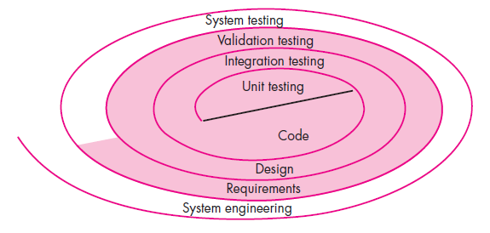
Testing strategy
Slide-5
SB

Slide 6
Testing Strategy
Slide-6
We begin by ‘testing-in-the-small’ and move toward ‘testing-in-the-large’
For conventional software
The module (component) is our initial focus
Integration of modules follows
For OO software
Our focus when “testing in the small” changes from an individual module (the conventional view) to an OO class that encompasses attributes and operations and implies communication and collaboration
SB

Slide 7
Testing Strategic issues
Slide-7
Specify product requirements in a quantifiable manner long before testing commences
State testing objectives explicitly
Understand the users of the software and develop a profile for each user category
Develop a testing plan that emphasizes “rapid cycle testing”
Build “robust” software that is designed to test itself
Use effective technical reviews as a filter prior to testing; many errors will be eliminated before testing begins
Conduct technical reviews to assess the test strategy and test cases themselves
Develop a continuous improvement approach for the testing process
SB

Slide 8
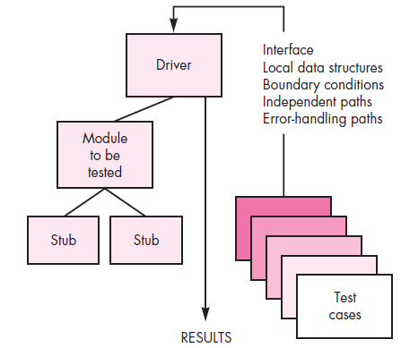
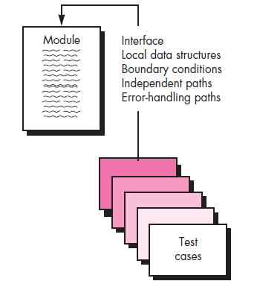
Unit testing
Slide-8
Tests a small software unit at a time, which is typically performed by the individual programmer who implemented the unit prior to Integration testing
Stub: it is the behavior of the lower-level modules that are under development and not yet integrated to other modules
SB

Slide 9
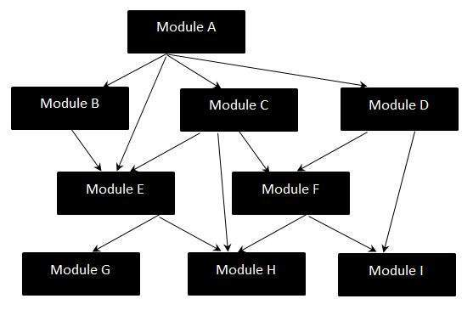
Integration testing strategies
Slide-9
System integration testing (SIT) is a systematic technique for assembling a software system while conducting tests to uncover errors associated with interfacing the modules
the “big bang” approach: Big Bang Integration Testing is an integration testing strategy where all units are linked at once, resulting in a complete system.
SB

Slide 10
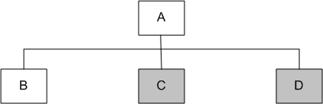
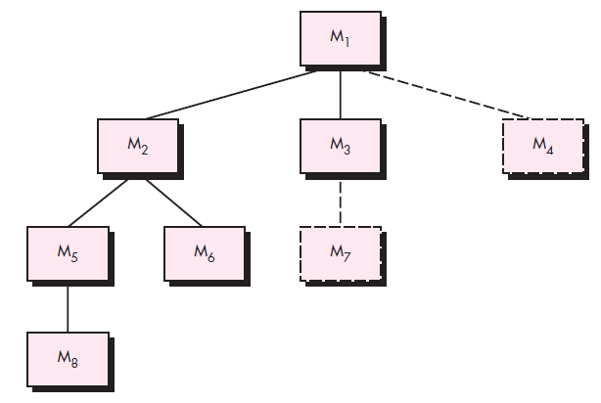
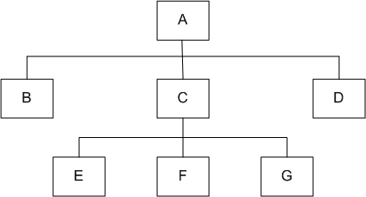
Top-down Integration
Slide-10
top module is tested with stubs down to the bottom
Fig.1
stubs are replaced one at
a time, "depth first"
as new modules are integrated,
some subset of tests is re-run
Fig.2
SB
Notes:
Module A has been decomposed into modules B, C, and D
Modules B, D, E, F, G are terminal modules (Fig.2)
First integrate modules A and B using stubs C and D (represented by grey boxes)
Next stub D has been replaced with its actual instance D
Two kinds of tests are performed:
Test the interface between A and D
Regression tests to look for interface defects between A and B in the presence of module D
Stub C has been replaced with the actual module C, and new stubs E, F, and G
Perform tests as follows:
First, test the interface between A and C;
Second, test the combined modules A, B, and D in the presence of C

Slide 11
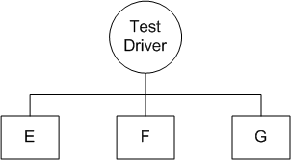
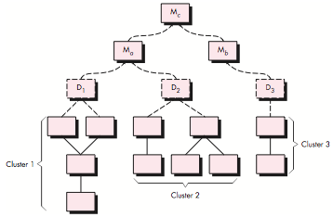
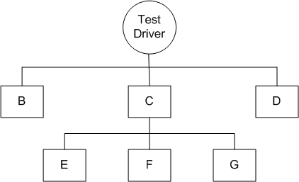
Bottom-up Integration
Slide-11
Fig 1: Bottom-up integration of modules E, F, and G
Fig 2: Bottom-up integration of modules B, C, and D with E, F, and G
SB
Notes:
We design a test driver to integrate lowest-level modules E, F, and G
The test driver simulates module C to integrate E, F, and G in a limited way.
The test driver (C) is replaced with the actual module
A new test driver is used for more modules such as B and D are integrated
The new test driver mimics the behavior of module A, finally
The test driver is replaced with module A and further tests are performed after the testers are satisfied

Slide 12
Regression testing
Slide-12
Regression testing is the re-execution of some subset of tests that have already been conducted to ensure that changes have not propagated unintended side effects
Whenever software is corrected, some aspect of the software configuration (the program, its documentation, or the data that support it) is changed.
Regression testing helps to ensure that changes (due to testing or for other reasons) do not introduce unintended behavior or additional errors.
Regression testing may be conducted manually, by re- executing a subset of all test cases or using automated capture/playback tools.
SB

Slide 13
smoke testing
Slide-13
Smoke testing steps:
Software components that have been translated into code are integrated into a “daily build”
A build includes all data files, libraries, reusable modules, and engineered components that are required to implement one or more product functions.
A series of tests is designed to expose errors that will keep the build from properly performing its function.
The intent should be to uncover “show stopper” errors that have the highest likelihood of throwing the software project behind schedule.
The build is integrated with other builds and the entire product (in its current form is smoke tested daily.
The integration approach may be top down or bottom up.
SB

Slide 14
Object-oriented testing
Slide-14
Class testing is the equivalent of unit testing
Operations within the class are tested
The state behavior of the class is examined
Integration applied three different strategies
Thread-based testing—integrates the set of classes required to respond one input or event
Use-based testing—integrates the set of classes required to respond to one use case
Cluster testing—integrates the set of classes required to demonstrate one collaboration
SB

Slide 15
Higher order testing
Slide-15
System testing: focus is on system integration (e.g. hardware integration, OS compatibility)
Alpha/Beta testing: Alpha testing is simulated or actual operational testing by potential users or an independent test team at the developers' site. Alpha testing is often employed for off-the-shelf software as a form of internal acceptance testing, before the software goes to beta testing by users
Recovery testing: forces the software to fail in a variety of ways and verifies that recovery is properly performed
Security testing: verifies that protection mechanisms built into a system will, in fact, protect it from improper penetration
Stress testing: executes a system in a manner that demands resources in abnormal quantity, frequency, or volume
Performance Testing: test the run-time performance of software within the context of an integrated system (e.g. time required to response a request, compliance with operational constraints)
SB

Slide 16
Debugging
Slide-16
In many cases, the non-corresponding data are a symptom of an underlying cause as yet hidden error
The debugging process attempts to match symptom with cause, thereby leading to error correction
symptom may disappear when another problem is fixed
cause may be due to a combination of non-errors
cause may be due to a system or compiler error
cause may be due to assumptions that everyone believes
SB

Slide 17
Debugging techniques
Slide-17
Brute force testing
most common; but least efficient
memory dumps are taken, run-time traces are invoked, and the program is loaded with output statements (Dynamic Testing)
Backtracking
common debugging approach that can be used successfully in small programs
source code is traced backward (manually) until the cause is found
Cause elimination
a “cause hypothesis” is devised
if initial tests indicate that a particular cause hypothesis shows promise, data are refined in an attempt to isolate the bug (c/a-b where the possibility of a-b is zero)
SB

Slide 18
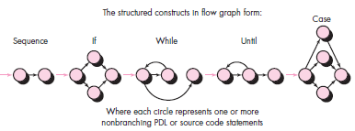
Basis-path testing
Slide-18
The basis path method enables the test-case designer to derive a logical complexity measure of a procedural design and use this measure as a guide for defining a basis set of execution paths
McCabe views a program as a directed graph in which lines of program statements are represented by nodes and the flow of control between the statements is represented by the edges
Flow Graph
SB

Slide 19
Independent program paths
Slide-19
Path 1: 1-11
Path 2: 1-2-3-4-5-10-1-11
Path 3: 1-2-3-6-8-9-10-1-11
Path 4: 1-2-3-6-7-9-10-1-11
Note that each new path introduces a new edge. The path 1-2-3-4-5-10-1-2-3-6-8-9-10-1-11 is not considered to be an independent path because it is simply a combination of already specified paths and does not traverse any new edges.
How do you know how many paths to look for? The computation of cyclomatic complexity provides the answer
SB

Slide 20
Cyclomatic complexity
Slide-20
Cyclomatic complexity is a software metric that provides a quantitative measure of the logical complexity of a program. Complexity is computed in one of three ways:
The number of independent paths
The number of regions of the flow graph corresponds to the cyclomatic complexity. (in the previous example = 4)
Cyclomatic complexity V(G) for a flow graph G is defined as V(G) = E - N + 2 (in the previous example 11 -9 + 2 = 4)
where E is the number of flow graph edges and N is the number of flow graph nodes.
Cyclomatic complexity V(G) for a flow graph G is also defined as V(G) = P + 1 (in the previous example 3 + 1 = 4) [condition: 1; 2,3; 6]
where P is the number of predicate nodes (containing a condition) contained in the flow graph G
SB

Slide 21
White-box testing
Slide-21
Using white-box testing methods, you can derive test cases that
guarantee that all independent paths within a module have been exercised at least once,
exercise all logical decisions on their true and false sides,
execute all loops at their boundaries and within their operational bounds, and
exercise internal data structures to ensure their validity.
SB

Slide 22
Black-box testing
Slide-22
Focuses on the functional requirements of the software
Black-box testing attempts to find errors in the following categories:
incorrect or missing functions
interface errors
errors in external database access (accessibility)
behavior or performance errors
initialization and termination errors
SB

Slide 23
references
Slide - 23
R.S. Pressman & Associates, Inc. (2010). Software Engineering: A Practitioner’s Approach.
Kelly, J. C., Sherif, J. S., & Hops, J. (1992). An analysis of defect densities found during software inspections. Journal of Systems and Software, 17(2), 111-117.
Bhandari, I., Halliday, M. J., Chaar, J., Chillarege, R., Jones, K., Atkinson, J. S., & Yonezawa, M. (1994). In-process improvement through defect data interpretation. IBM Systems Journal, 33(1), 182-214.
SB

